Slide 1
What is the Efficacy of Flu Vaccines?
Can Test Indicators Predict Effectiveness of Vaccines

Slide 2

How serious is Flu?
Influenza can be a serious illness
5% to 20% of the U.S. population will get the flu annually
An average of 200,000 hospitalized with illness related problems
8,200 to 20,000 Americans die each year from flu-related cases
Average cost of hospitalizations and outpatient doctor visits related to the flu are over $10 billion
Historical flu epidemics such as Russian flu, Spanish flu, Asian flu, Hong Kong flu, H1N1 flu

Slide 3
Why FLuPRINT?
Search for effective vaccines
A research project investigating influenza vaccine imprints on the immune system, funded by the European Commission, led to the creation of the FluPRINT database
Unified database is the result of a large-scale study exploring novel cellular and molecular underpinnings of successful immunity to influenza vaccines
Contains information on more than 3,000 parameters
The dataset represents a unique source in terms of value and scale, which will broaden the understanding of influenza immunity

Slide 4
Key Business Questions
The dataset contains information regarding different vaccine types
Contains vaccine responses evoked in the donors
Test results indicated whether the response to the vaccine was high or low
Understanding the data led to business questions:
Are there tests that are better indicators as to whether or not a donor will respond highly?
In addition, are there any indicators that would predict whether a person will still get the flu, even after vaccination?

Slide 5
Data Analysis
The data contains information on each donor, such as gender, race, age, Body Mass Index (BMI), cytomegalovirus (CMV), Epstein-Barr virus (EBV), and the vaccine received at the visit
Field vaccine_resp field is classified as high or low responder
Samples were analyzed and information about which assays were performed (assay field) and the value of the measured analytes (units and data) were recorded
Each donor’s medical history was also recorded, including past influenza vaccines over the last 5 years, influenza infection history, and influenza-related hospitalization

Slide 6
How is the EDA done?
R and Python software used to perform EDA
The data was aggregated into another file that contained one record per donor in order to capture gender race, age, cmv status, ebv status, bmi, statin use, vaccine type, vaccine response, and influenza history and hospitalization
Both of the files were used for further regression testing

Slide 7
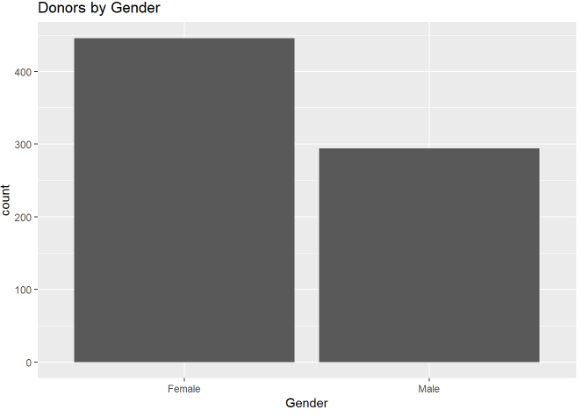
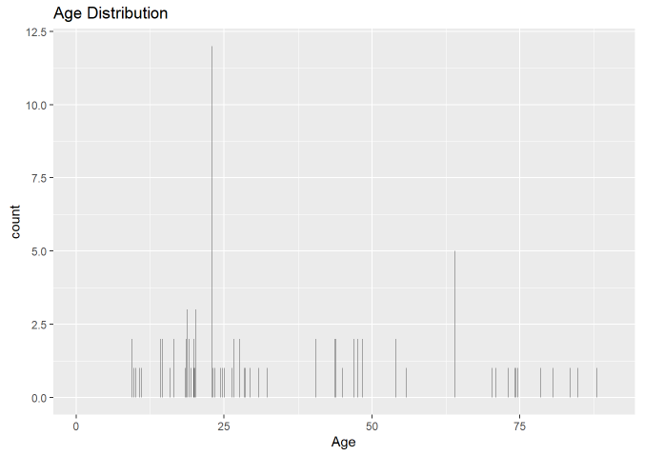
Gender and Age Charts

Slide 8
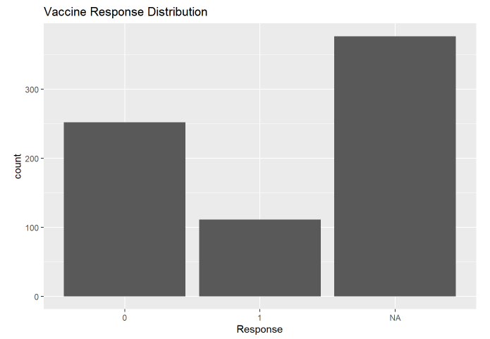
Vaccine Response Distribution

Slide 9
Aggregated data - Modeling and Results
Regression models were created using the aggregated donor file to test the correlations between a number of variables and outcomes
Using Aggregated data set, influenza infection variable was tested as a response to the type of vaccine, controlling for gender, age, and race of the donor, with no significant results
Another model tested the vaccine response as a response to the different vaccines administered, controlling for donor gender, age, and race
Showed a small significant correlation between vaccines 2 and 4 and a high response to the vaccine

Slide 10
Entire data - Modeling and Results
Regression model was used to test the vaccine response variable as a response to the data variable, controlling for gender, age and race of the donor
The data variable was the measured values of the different assays tested on the donors.
The model indicated a significant negative correlation between the data and the response to the vaccine
Also showed a positive correlation between the males and the age of the donors.

Slide 11
More Regression models…
Regression models were performed on subsets of the data
Based on five different measured analytes that had the most positive vaccine responses among donors
Models indicated that the analytes measured for CD8+ T cells had the most significant negative correlation
CD4+ T cells and T cells analytes had minor significant positive correlation
NK cells analytes had minor negative significant correlation
B cells analytes had no significant correlation at all

Slide 12
Conclusion
Some significant correlation between vaccines 2 and 4 and having a high vaccine response.
Vaccine 2 was the Fluzone Intradermal, and vaccine 4 was Fluzone
Some indication that the administration of these vaccines have a more significant impact on a recipient having a better chance for a high response to an influenza vaccination than the other types of vaccines given

Slide 13
Conclusion.. Contd’
Analyte used to measure CD8+ T cells seems significant
A low data score is significantly correlated to having a high response to a vaccine
Seems to be a good indicator that a donor receiving a vaccine would have an improved chance of having a higher response to a vaccine, if this measure has a low data value
This test could be used to predict who will respond better to flu vaccinations

